Slide 1
Introduction to Troubleshooting
Module 2

Slide 2
Importance
Understanding troubleshooting techniques is a requirement and a desired skill. Excellent troubleshooters armed with technical knowledge and superior logic can quickly identify a problem, diagnose the cause, and apply the proper solution. You must be able to use the methodology of efficient troubleshooting in a consistent and repeatable manner.

Slide 3
Learner Objectives
By the end of this module, you should be able to meet the following objectives：
Use a structured approach to solve configuration and operational problems
Apply troubleshooting methodology to logically diagnose faults and improve troubleshooting efficiency

Slide 4
You Are Here
Course Introduction
Introduction to Troubleshooting
Troubleshooting Tools
Troubleshooting Virtual Networking
Troubleshooting Storage
Troubleshooting vSphere Clusters
Troubleshooting vCenter Server and ESXi
Troubleshooting Virtual Machines

Slide 5
Definition of a System Problem
A system problem is a fault in a system, or one of its components, that negatively affects the services needed for normal production.
System problems arise from various sources:
• Configuration issues
• Resource contention
• Network attacks
• Software bugs
• Hardware failures

Slide 6
Effects of a System Problem
These problems can affect certain aspects of a system:
• Usability
• Accuracy
• Reliability
• Performance
Perceived effects or symptoms are generally exposed and reported. Symptoms of a system problem often appear to be the problem itself.
Your must look at all of the symptoms of a system problem to determine the root cause.

Slide 7
Adopting a Troubleshooting Process
Troubleshooting is a systematic approach to identifying the root cause of a problem and defining steps to resolve the problem.
The troubleshooting process consists of several tasks:
1. Define the problem.
Identify symptoms.
Gather supplemental information.
2. Identify the cause of the problem.
Identify possible causes.
Determine the root cause.
3. Resolve the problem.
Identify possible solutions.
Implement the best solution.

Slide 8
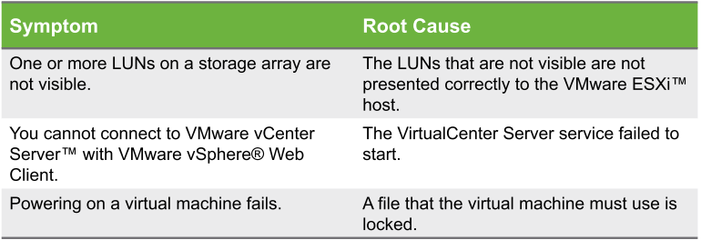
Collecting Symptoms of a Problem
Collecting symptoms is the first step in troubleshooting a problem.
A single root cause often presents itself as several symptoms that users report.
Differentiating between symptoms and the root cause of a problem is imperative.

Slide 9
Gathering Supplemental Information
Ask questions to gather additional information to define the problem:
Can the problem be reproduced?
Provide a repeatable means to recreate the problem and a way to validate that the problem was resolved.
What is the scope?
Does the problem affect only one object or multiple objects?
Was the system working before?
If so, what changed in the environment or configuration?
Is the problem a known problem?
Consult references, such as release notes, to determine whether the problem is documented.

Slide 10
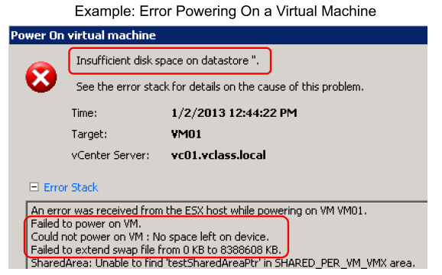
Viewing and Interpreting Diagnostic Information
View diagnostic messages in the GUI or in log files.
Interpret the diagnostic messages to find the root cause.

Slide 11
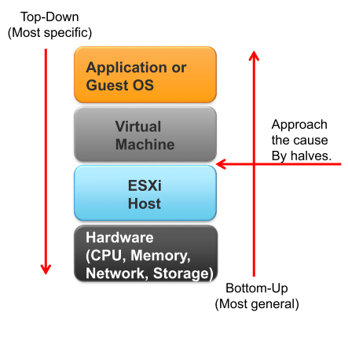
Identifying Possible Causes and Taking an Appropriate Approach
A structured approach to troubleshooting enables you to determine the root cause quickly and effectively.
Based on the problem’s characteristics, take one of the following troubleshooting approaches:
Investigate the cause top-down.
Investigate the cause bottom-up.
Approach the cause by halves.

Slide 12
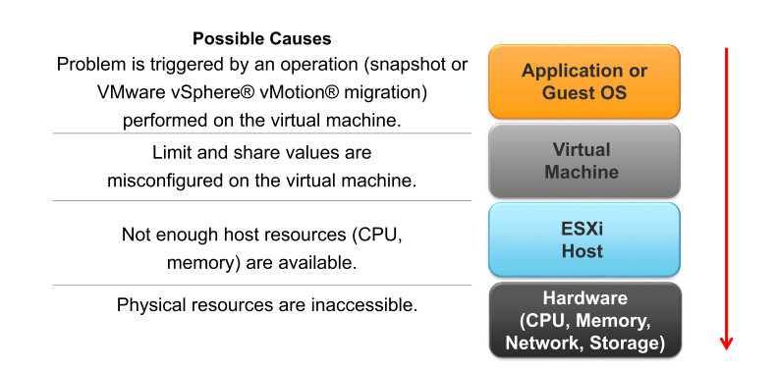
Determining the Root Cause
To determine the root cause, test your environment and eliminate possible causes.
Example: The virtual machine stopped responding.

Slide 13
Resolving the Problem
After identifying the root cause, assess the impact of the problem on operations:
High impact: Resolve immediately.
Medium impact: Resolve when possible.
Low impact: Resolve during next maintenance window.
Identify possible solutions and their impact on the VMware vSphere® environment:
Short-term solution: Workaround.
Long-term solution: Reconfiguration.
Impact analysis: Assess the impact of the solution on operations.
Resolve the problem by implementing the most effective solution.

Slide 14
Example Scenario: Defining the Problem
Scenario:
You attempt to migrate the virtual machine named VM01 from the host named ESXi01 to the host named ESXi02. After waiting a couple of minutes, the vSphere vMotion migration fails with an error.
Is this failure a vSphere vMotion problem or a symptom of an underlying problem?
The error message might reveal some clues.

Slide 15
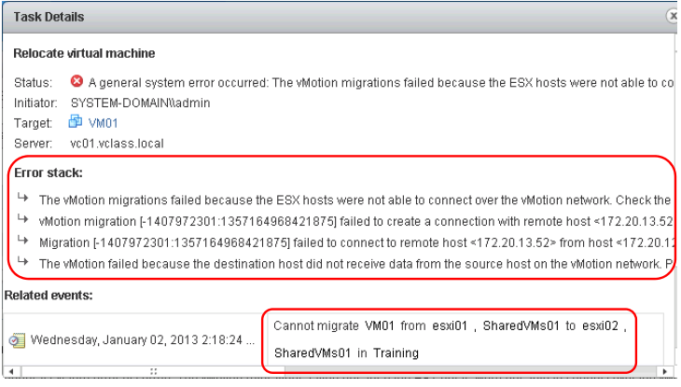
Example: Gathering Information
Error messages can help determine the problem.

Slide 16
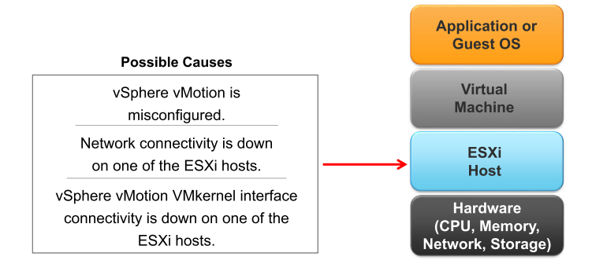
Example: Identifying Possible Causes
Use the information that you gathered to identify possible causes:
Based on error messages, the vSphere vMotion migration failed because ESXi01 and ESXi02 failed to connect over the network named vMotion.
This error indicates a possible misconfiguration on the ESXi host.
Check the connectivity of the vSphere vMotion VMkernel interface.

Slide 17
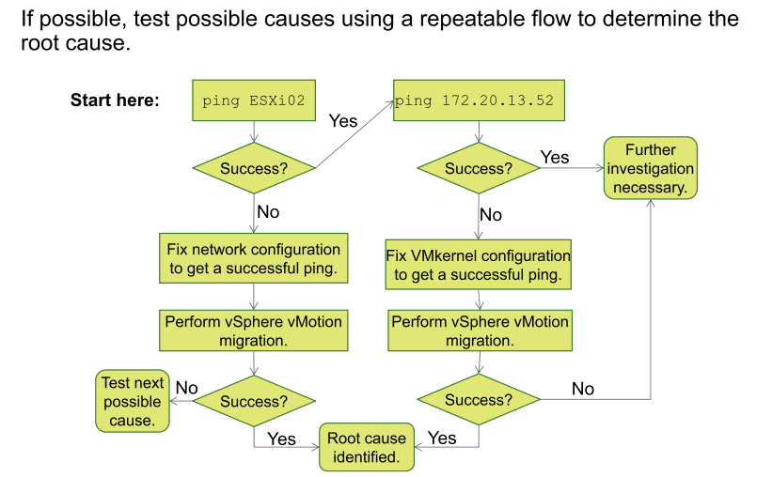
Example: Determining the Root Cause

Slide 18
Example: Resolving the Problem
In this example, assume that the root cause is an incorrect IP address of a VMkernel interface for vSphere vMotion on the ESXi02 host.
Assess the impact of the problem on operations:
Probably high impact:
The problem affects any virtual machine that is migrated to the ESXi02 host.
The problem also affects the proper operation of VMware vSphere® Distributed Resource SchedulerTM.
Identify possible solutions to resolve the problem:
Short-term solution: Do not migrate virtual machines to the ESXi02 host.
Long-term solution: Fix the IP address of the vSphere vMotion VMkernel interface of the ESXi02 host.
Implementing the solution should not require downtime.

Slide 19
Review of Learner Objectives
You should be able to meet the following objectives:
Use a structured approach to solve configuration and operational problems
Apply troubleshooting methodology to logically diagnose faults and improve troubleshooting efficiency

